Slide 1
-Analysis of Chinese Restaurant around Boston
Opening a Successful Chinese Restaurant:
Location and Advertising Strategies
BUS211 Group7
Lian Liu | Guangji Tang | George Nekwaya | Qinghao Yang

Slide 2
Table of contents
Introduction
Data analysis
Popularity
Dwell time
Distance
Advertising strategy
Conclusion
Pros and cons of this project

Slide 3
Introduction
This project aims to provide information helping people making decisions about where to open a Chinese restaurant, inside the Chinatown or out of the Chinatown.
In addition, based on where Chinese restaurant customers go before or after visiting the restaurant, recommendation of where to post advertisements will be provided.

Slide 4
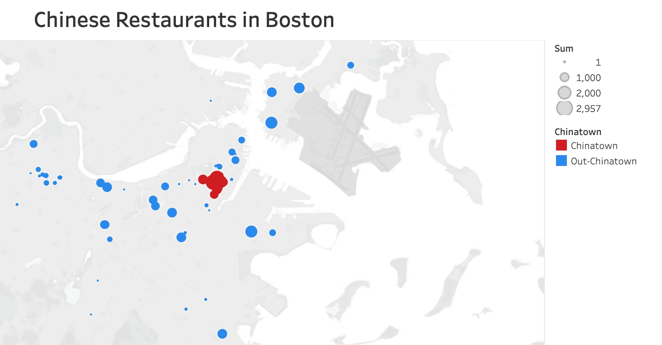

Slide 5
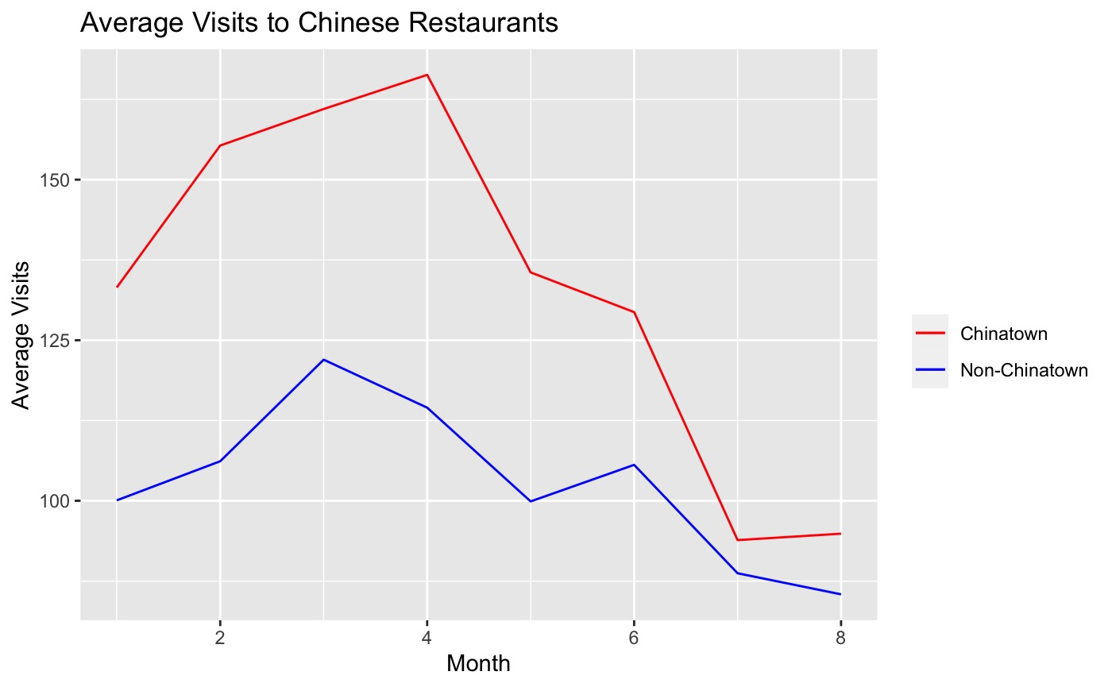
Popularity

Slide 6
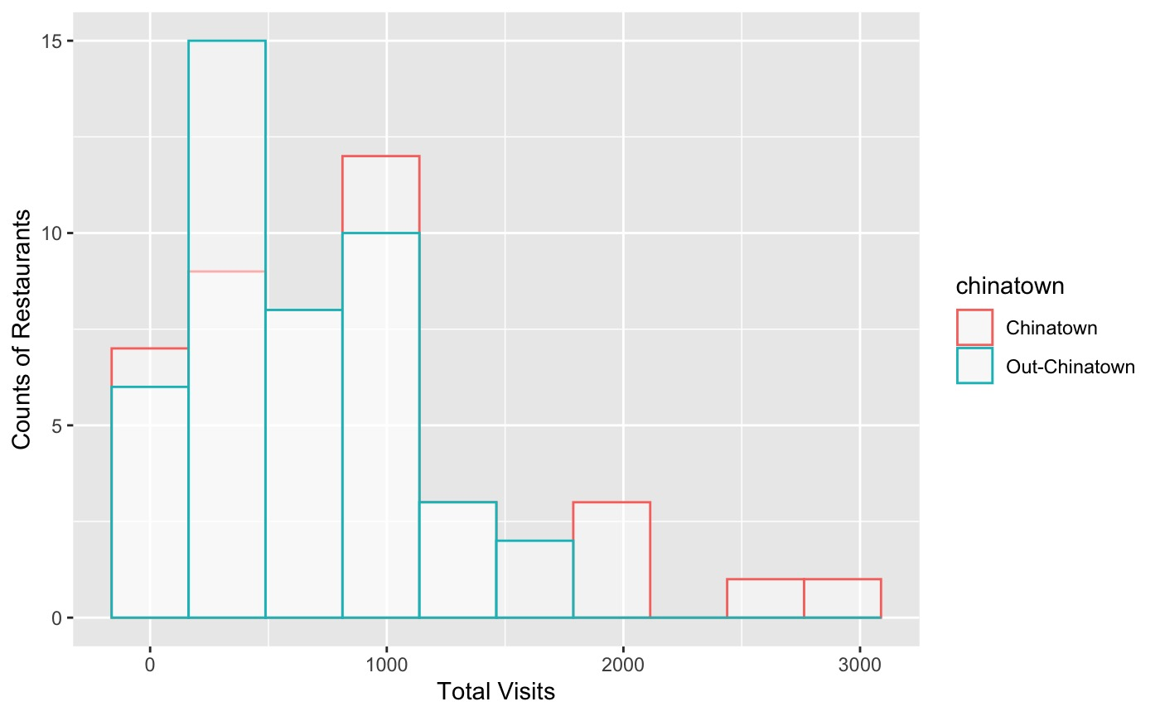
Popularity continued

Slide 7
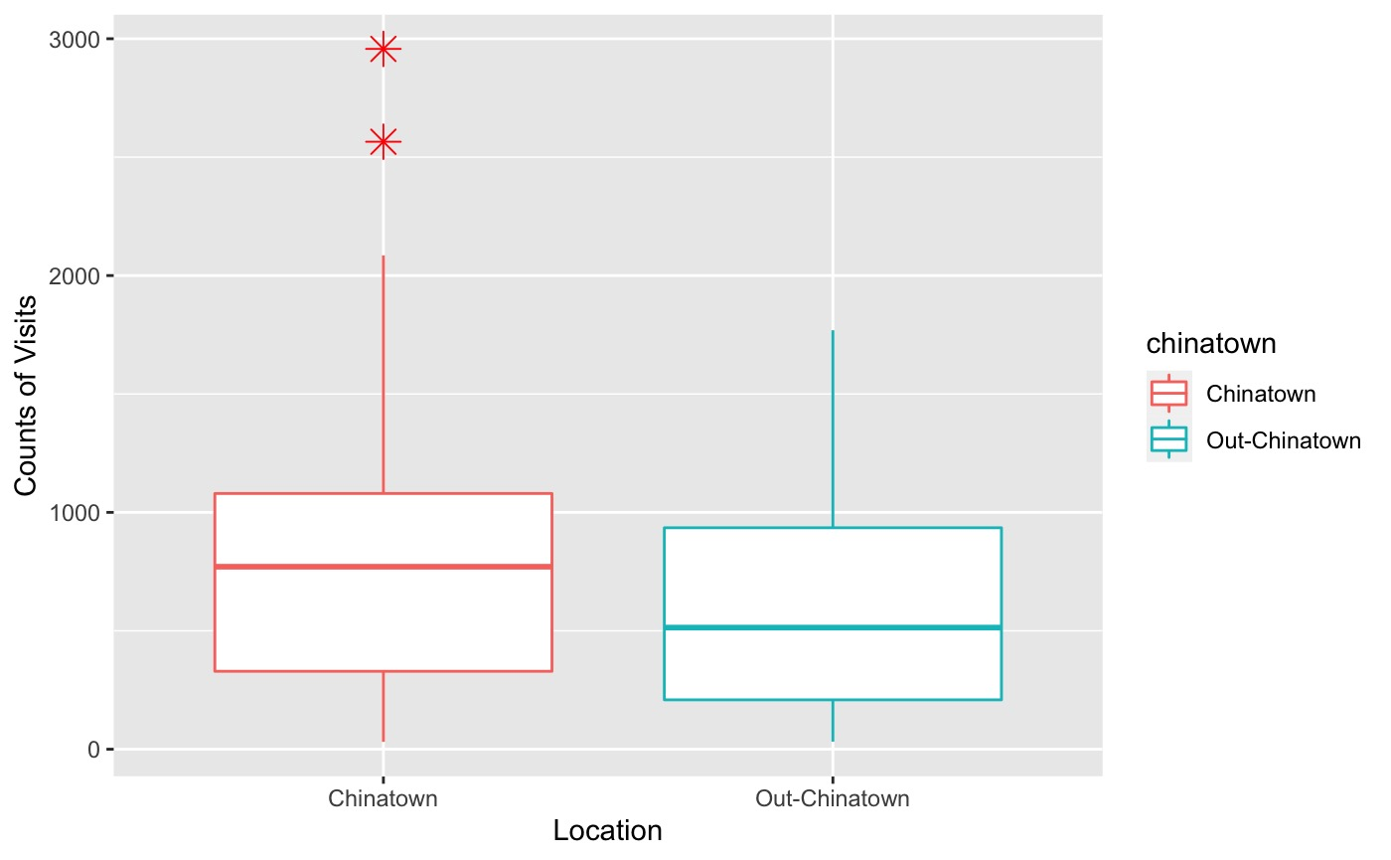
Popularity continued

Slide 8
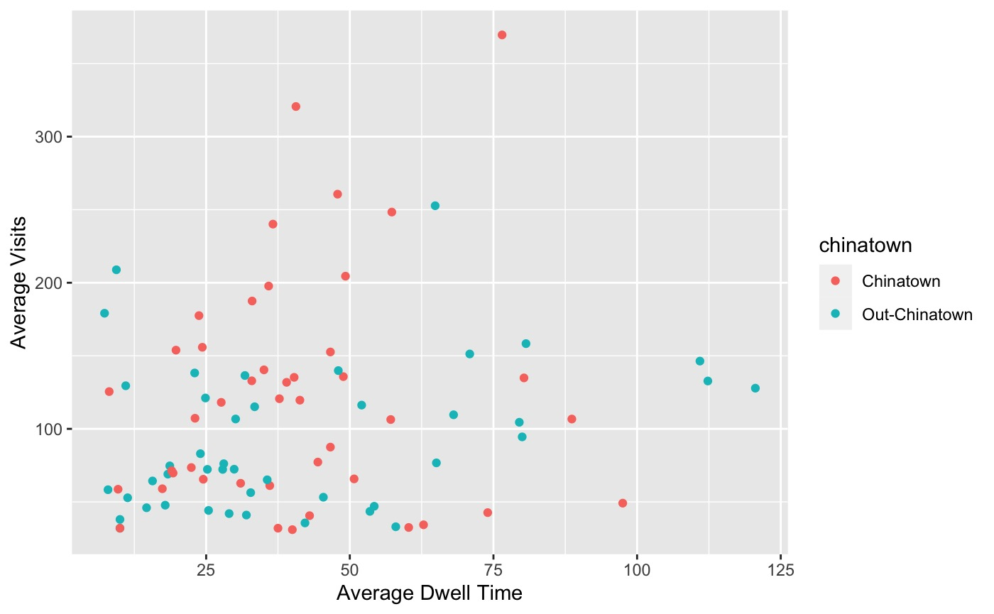
Dwell time

Slide 9
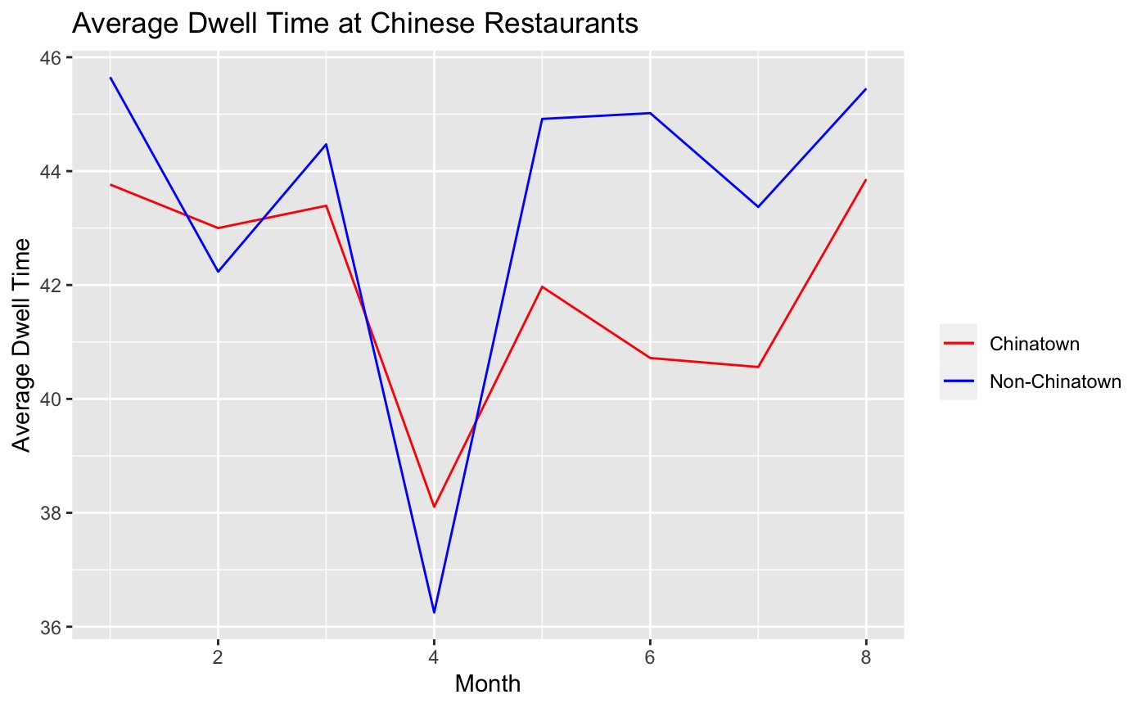
Dwell time continued

Slide 10
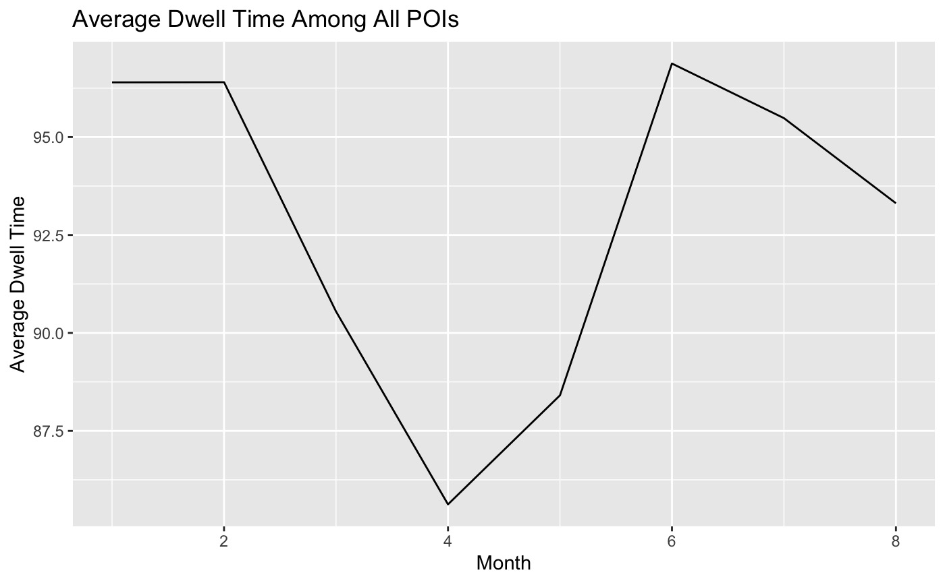
Dwell time continued

Slide 11
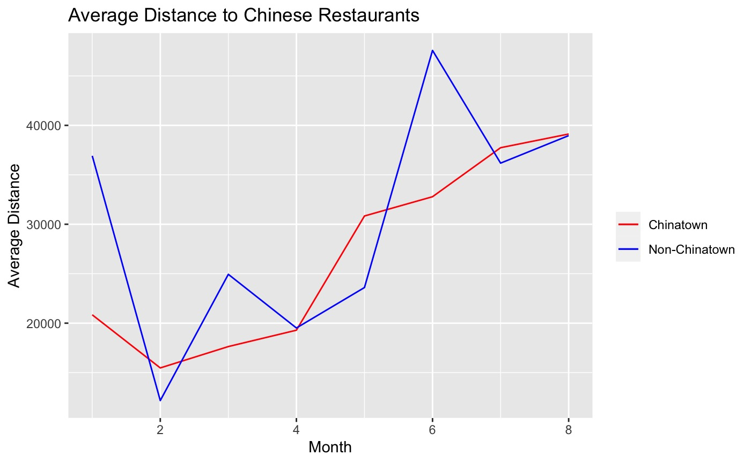
Distance

Slide 12
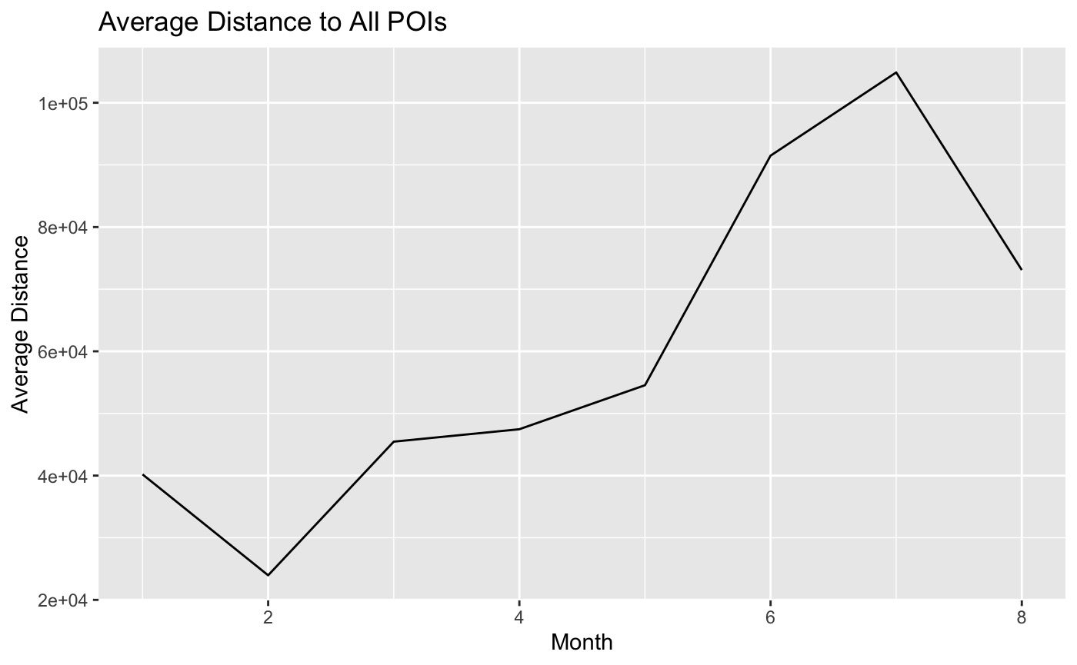
Distance continued

Slide 13
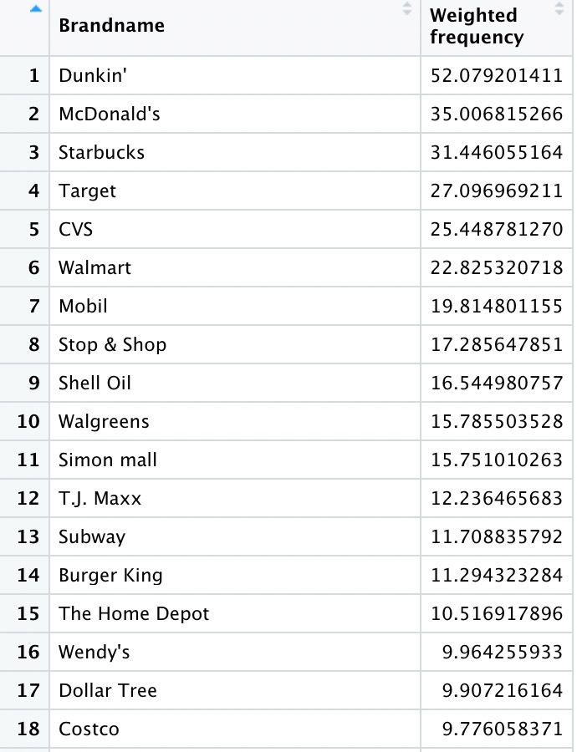
Advertising Strategies
Advertising strategies based on data analysis:
1.To do some promotion which targets travelers during Summer break.
2.To advertise at the brands of Chinese restaurants customers’ favor.
3.To advertise in front of Competitor Chinese Restaurants.

Slide 14
Conclusion
Conclusion1:
Choosing Chinatown: more visitors and more popular; more competitors.
Choosing outside-Chinatown: less competitors; less popular
Conclusion2:
Operating strategy: hiring more employees during April
Organize more events when there is less consumers, in order to attract them
Conclusion3:
Advertising strategies

Slide 15
Pro and cons
Pros1: We use as much as the data set
Pros2: We use graphs to show the trends
Cons1: There are many mistakes in the data set.
Cons2: The number of observations is limited
Cons3: We only divided our interesting part into two parts.

Slide 16
Q & A Section

